Slide 1

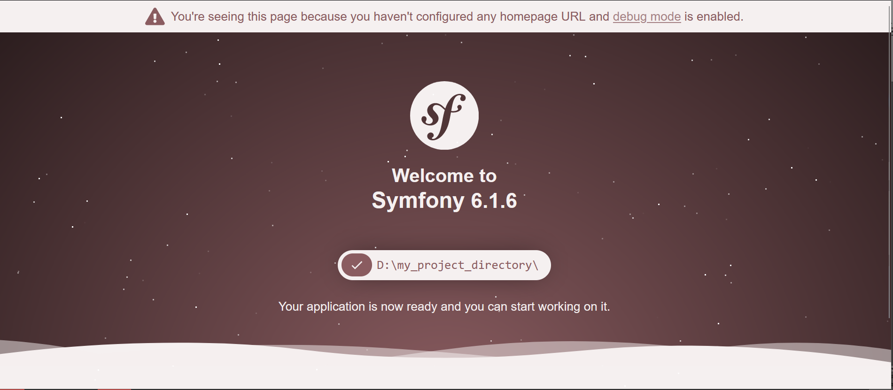
What is Symfony ?
A quick presentation of the Symfony Framework

Slide 2
PRESENTATION
Hello my name is Philippe Da Costa ,future application web designer and developer.

Slide 3
What are we going to talk about?
Framework definition
Prerequisite
Tools
Installation
First project
Project contents
Priricouisite // proiject

Slide 4
Framework definition
First of all, what is a framework ?
A framework is based on an application architecture. It offers a set of coherent tools and software components, such as a reusable software library. Its technical and logical structure requires the developer to respect certain development practices and standards.
Baste //reusabeulle // liebrary.

Slide 5

What is SYMFONY?
Symfony is a Framework that represents a set of standalone PHP components, that can be used in private or open source web projects. But it is also a powerful PHP Framework developed(t) by a French company: SensioLabs.
It aims to simplify the construction of your PHP projects.
For more details on the creators:
https://sensiolabs.com
(also called libraries)
(Check this link) (developed(t) )

Slide 6
Prerequisites...
1: (je regarde les auditeurs)
Before starting with Symfony,
(Je lis)
it is recommended to have a basic knowledge of its language
(je regarde les auditeurs)
which is PHP.
2: (je regarde les auditeurs)
Have some knowledge of HTML /CSS
(je regarde les auditeurs)
3: Have a database installed (my-Sql, MariaDB...)
(Je lis)
4: A PHP version compatible with the symfony version used
example :for Symfony 6 : php8 is required.
Priricouisite // instoll’d // ious’t

Slide 7
Facilities
COMPOSER
SCOOP
SYMFONY CLI

Slide 8
Installation of « composer »
Composer is a dependency manager.
Go to: https://getcomposer.org/ and follow the steps for your operating system. To check if the installation is working, go to a terminal and type the command below.
composer –version
If successful the command will display the version number of composer as below:
Composer version 2.2.1 2021-12-22 22:21:31

Slide 9
Installation of scoop
Scoop is a CLI (command-line installer)for Windows.
Install it from the command line using the POWERSHELL terminal of windows 5.1 or higher with these two commands:
1: Set-ExecutionPolicy RemoteSigned -Scope CurrentUser (on first use)
2: irm get.scoop.sh
Now Scoop is installed on your machine

Slide 10
Symfony CLI
It is recommended to use the Symfony CLI command line interface that you can find on https://symfony.com/download
To check if the installation is working, go to a terminal and type the command below.
symfony -- version
The version should look like this:
Symfony CLI version 5.4.16 (c) 2017-2022 Symfony SAS
Now we can finally use SYMFONY...

Slide 11
First project
We will finally generate our first project with SYMFONY.
From the desired location, right click on the mouse and select:
git bash here.
Enter the following command to create the project:
symfony new my_project_directory --version="6.1.*" –webapp
Once this is done, the project structure is on your location.
But what does this project contain?

Slide 12
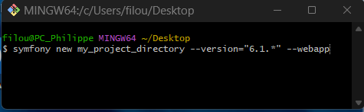
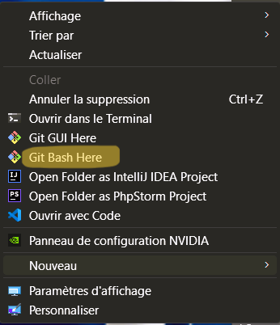
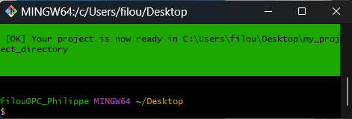
There's nothing like a picture
Access to git
install

